Slide 1

DATA 606:
Capstone in Data Science (Final Presentation)
Portfolio Performance
Analysis
Group Members:
Chirag Jadav
Harshil Prajapati

Slide 2
What is Portfolio Performance Analysis ?
A tool which takes user input for selecting asset, desired date range, market index to show performance analysis of it. This tool has three features:
Asset Comparison
Portfolio Performance evaluation
Forecast Portfolio’s Return

Slide 3
Asset Comparison
Feature shows comparison of asset’s various characteristics to see how each asset is performing compared to other. This feature includes
Historical data and Asset’s Return Comparison
Volatility Comparison
Drawdown Comparison

Slide 4
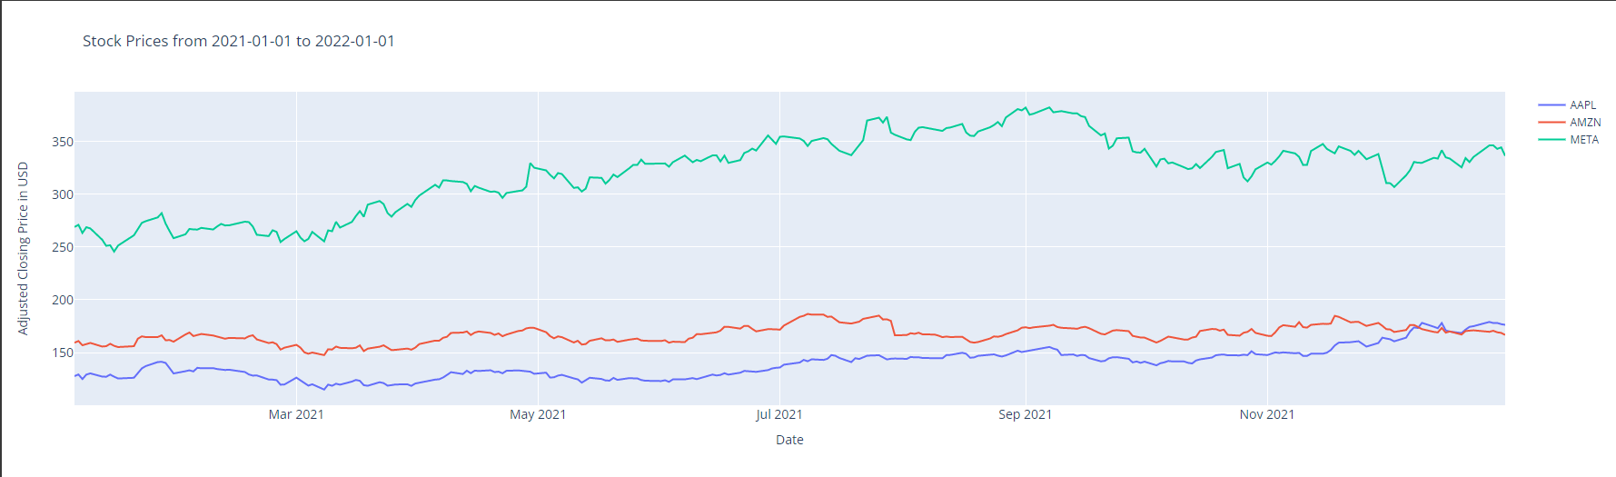

Historical data Comparison
Reads Adj. Closing Price from Yahoo Finance and plots using plotly.
Shows return the asset have given for a selected period

Slide 5
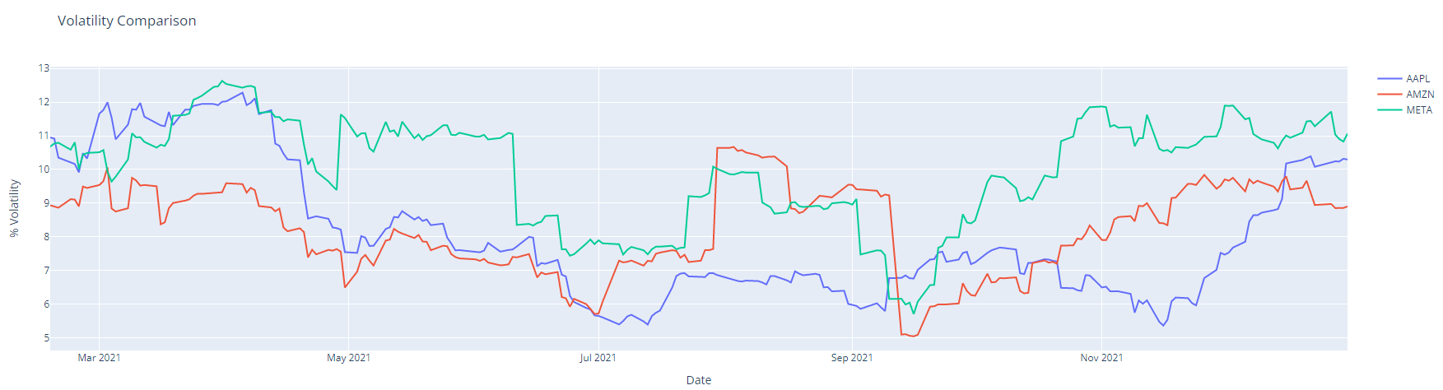
Volatility Comparison
Rolling volatility calculated using 30 days window

Slide 6
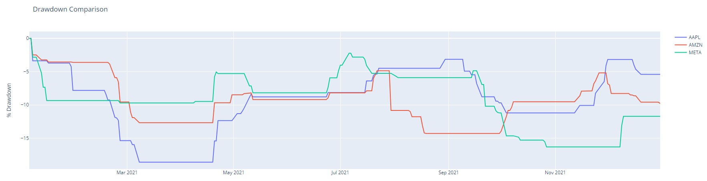
Drawdown Comparison
Rolling Drawdown calculated using 30 days window.

Slide 7
Portfolio Performance Evaluation
This feature calculates portfolio’s return over selected period by considering the amount to be invested which is entered by user and weights allocated to each asset. This feature includes:
Stock Portfolio Performance
Sharpe Ratio
Risk Return Tradeoff

Slide 8
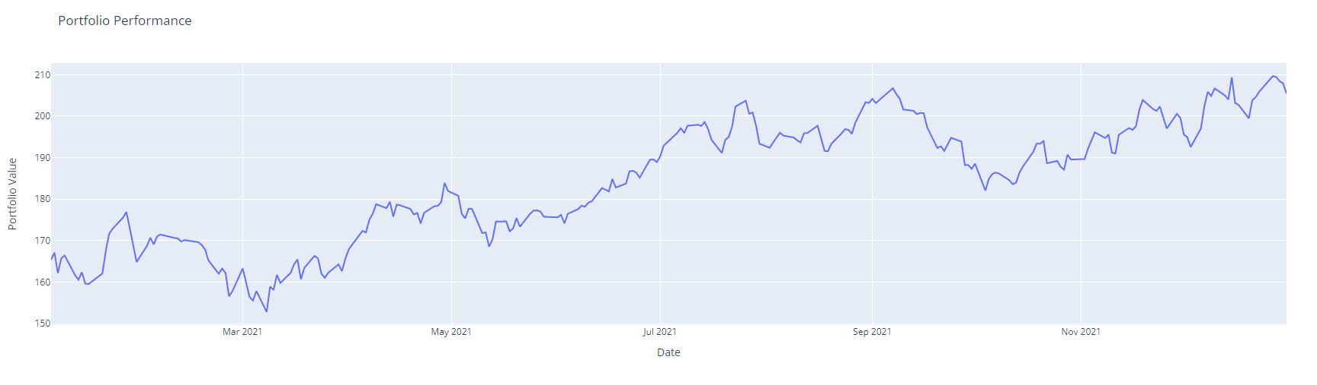
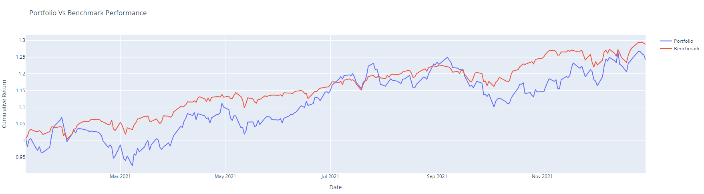
Portfolio Performance

Slide 9
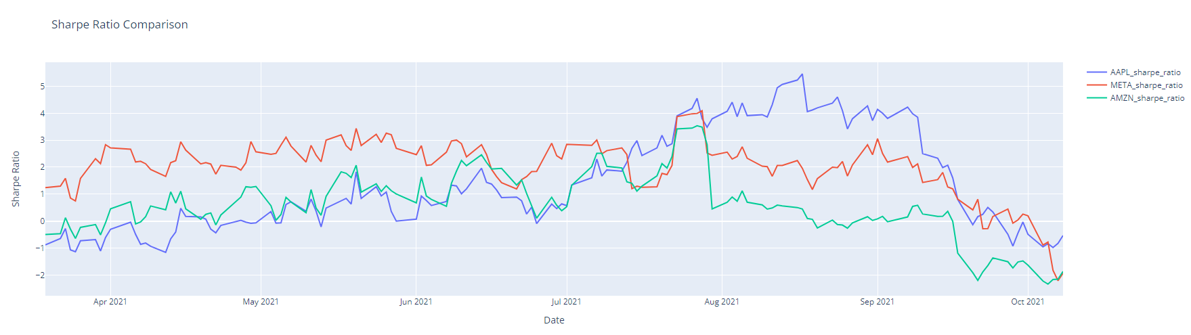
Sharpe Ratio
Rolling Sharpe ratio calculated fetching T-bill rate by FRED API

Slide 10
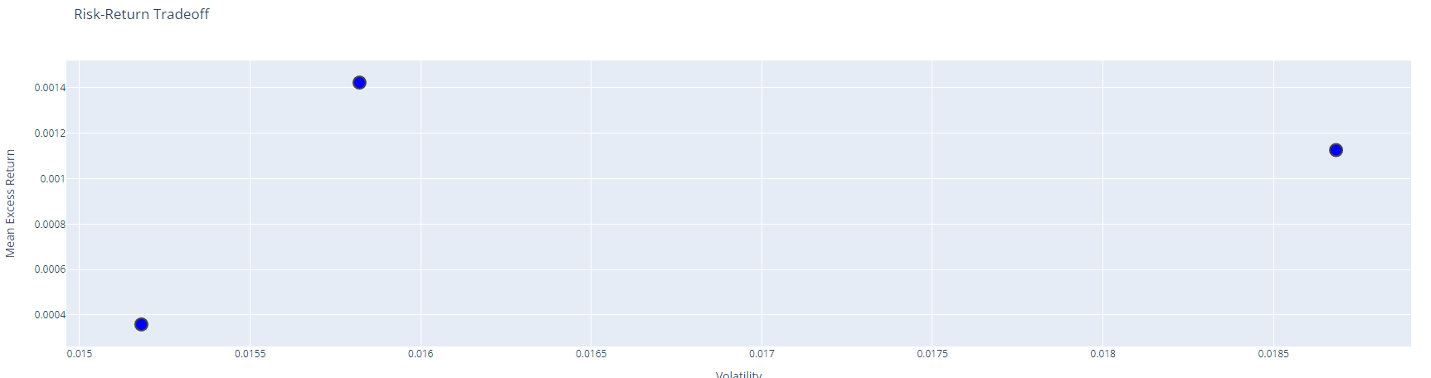
Risk Return Tradeoff
Risk-Return trade-off plot to see risk associated with return of each asset

Slide 11
Forecast Portfolio Return
This feature uses statistical techniques and modeling to forecast the portfolio’s Return for next 30 days using ARIMA (Auto-Regressive Integrated Moving Average) model.
The accuracy is evaluated using MAPE, MAE, MSE and RMSE matrices.
It also predicts the return your portfolio will experience over a forecasted period.

Slide 12
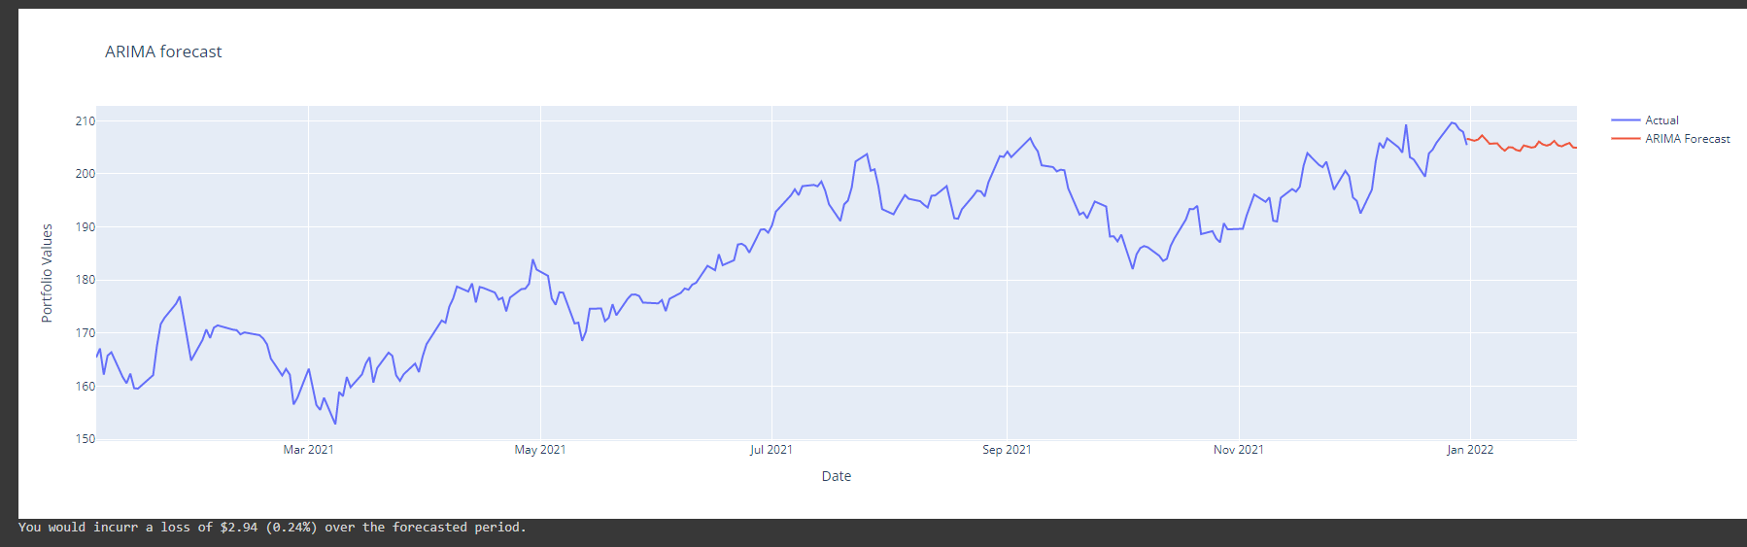
ARIMA FORECAST
Accuracy matrix:

Slide 13
Code Walk Through

Slide 14
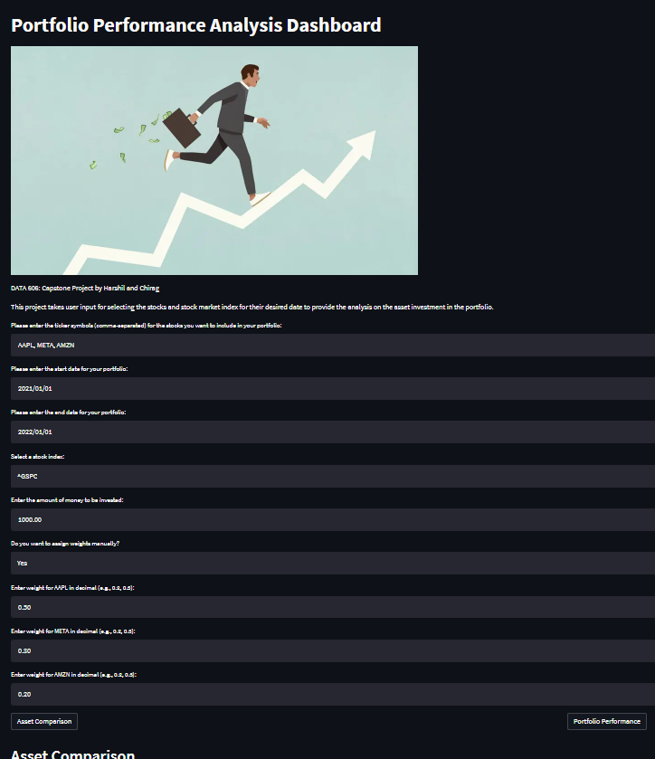
STREAMLIT
Created web page for Portfolio Performance Analysis Tool using Streamlit.

Slide 15
THANK YOU

